Slide 1
COVID 19 DataSET Analysis with SQL
Unraveling Insights Through Data
Rakib Hasan Rahad
05/05/2024

Slide 2
TABLE OF CONTENTS
01
02
Introduction and Dataset Overview
Monthly Trends and Significant Figures
03
04
Analyzing Extremes and Spread
Geographical Insights

Slide 3



INTRODUCTION
Brief Overview
The COVID-19 pandemic has caused unprecedented global disruption.
It has affected public health, economies, and societies worldwide.
Importance of Data-Driven Insights
Data-driven insights are crucial for understanding the spread of the virus.
They enable informed decision-making and effective response strategies.
Your Role as a Data Analyst
As a data analyst, your role is to analyze the Corona Virus dataset.
Your analysis will provide valuable insights to stakeholders and policymakers.

Slide 4
Dataset Overview
Description of Columns
Province: Geographic subdivision within a country/region.
Country/Region: Geographic entity where data is recorded.
Latitude: North-south position on Earth's surface.
Longitude: East-west position on Earth's surface.
Date: Recorded date of COVID-19 data.
Confirmed: Number of diagnosed COVID-19 cases.
Deaths: Number of COVID-19 related deaths.
Recovered: Number of recovered COVID-19 cases.

Slide 5
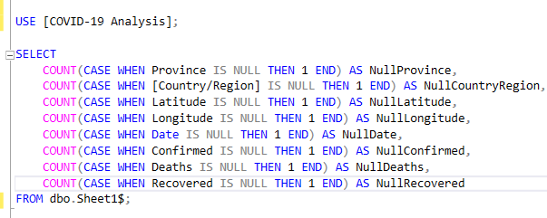
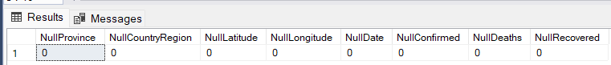
Data Preprocessing
Data Quality Check
Q1: Write a code to check NULL values

Slide 6
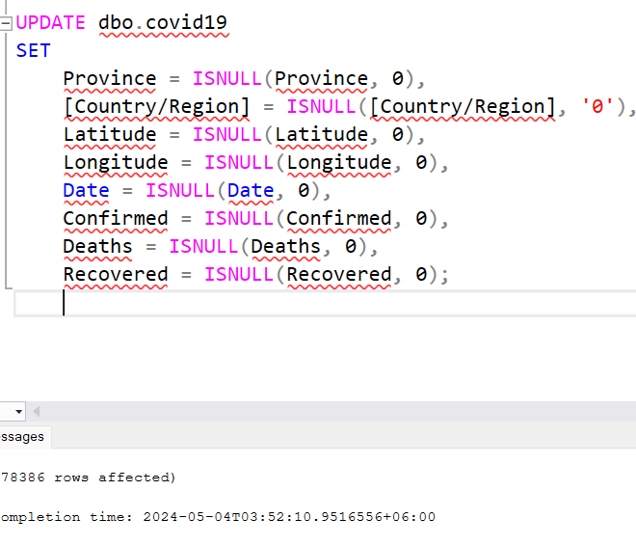
Data Preprocessing
Data Quality Check
Q2: If NULL values are present, update them with zeros for all columns

Slide 7
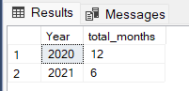
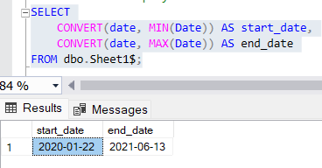
Dataset Information
Total number of rows in the dataset Number of months present in the dataset
Start date and end date of the dataset
78386

Slide 8
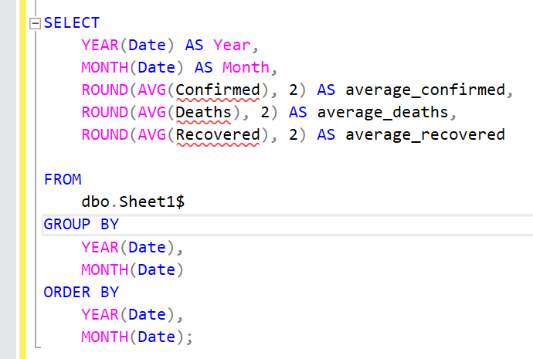
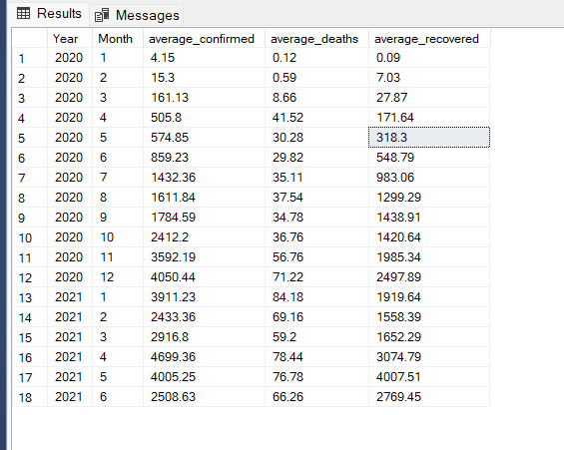
Monthly analysis
Q6: Find monthly average for confirmed, deaths, recovered

Slide 9
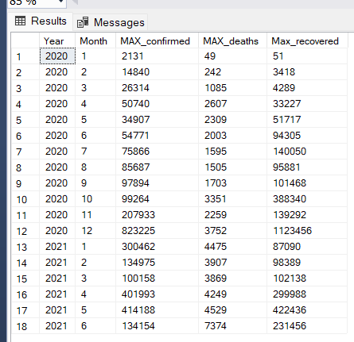
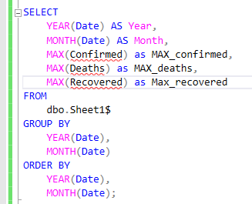
Most Frequent Values
Q7. Find maximum value for confirmed, deaths, recovered each month

Slide 10
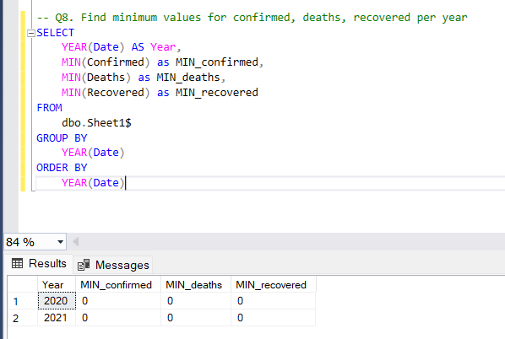
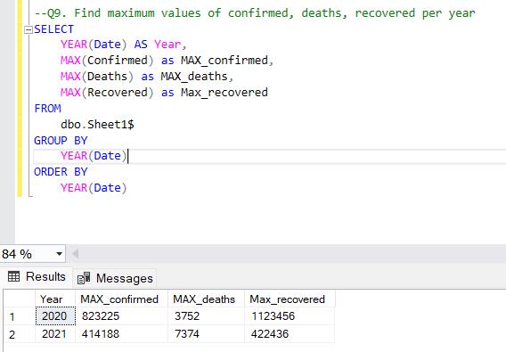
Extreme Analysis
Q8: Find minimum values for confirmed, deaths, recovered per year
Q9: Find maximum values of confirmed, deaths, recovered per year

Slide 11
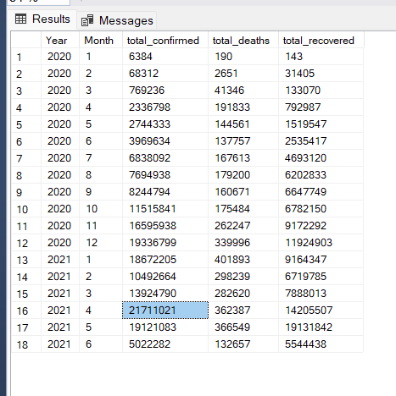
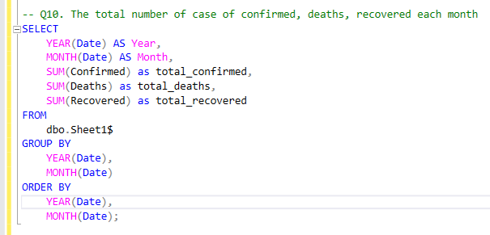
Spread analysis
Q10. The total number of case of confirmed, deaths, recovered each month

Slide 12
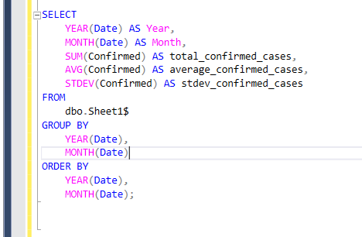
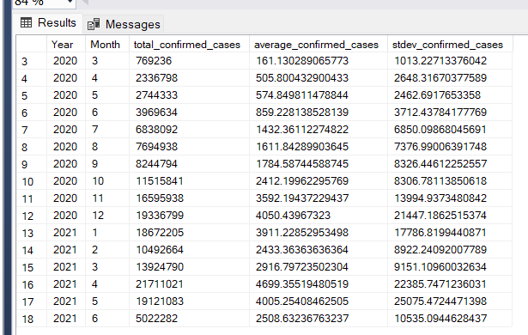
Spread analysis
Q11: Check how corona virus spread out with respect to confirmed case

Slide 13
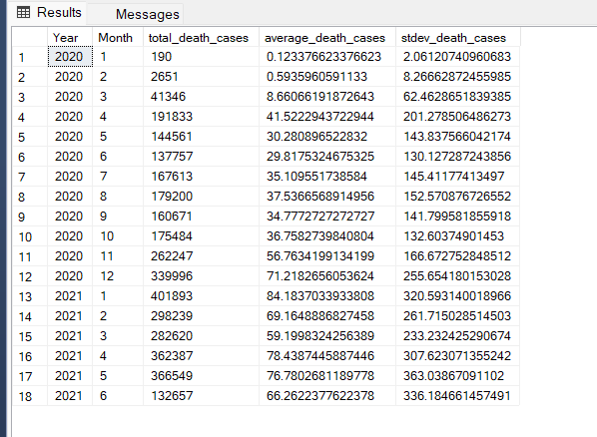
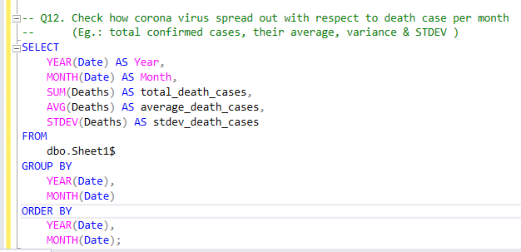
Spread analysis
Q12: Check how corona virus spread out with respect to death case per month

Slide 14
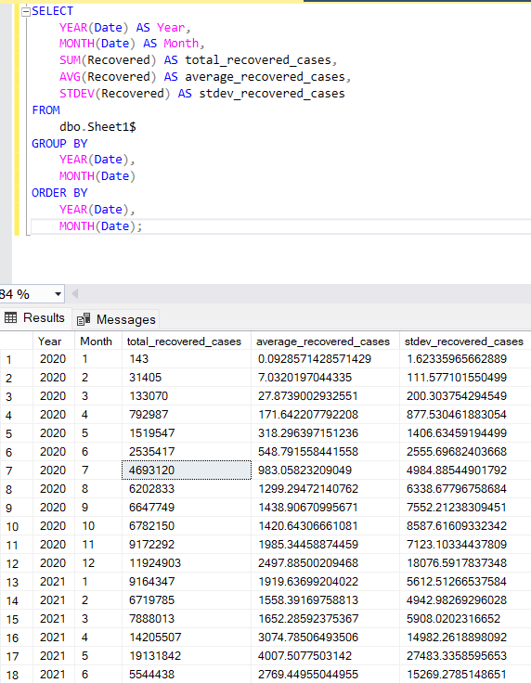
Spread analysis
Q13: Check how corona virus spread out with respect to recovered case

Slide 15
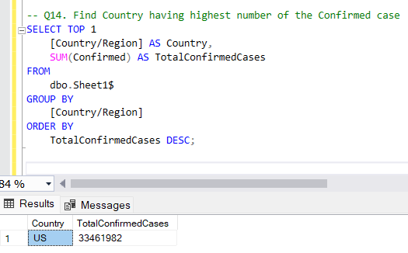
Geographical Analysis
Q14: Find Country having highest number of the Confirmed case

Slide 16
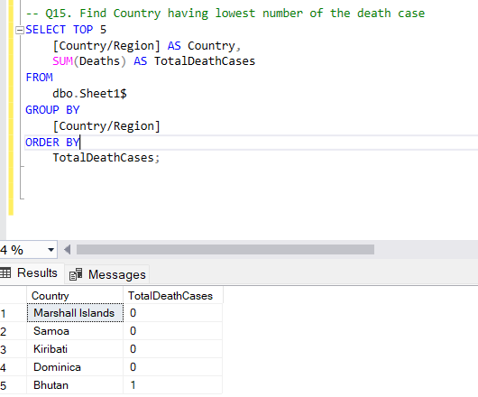
Geographical Analysis
Q15: Find Country having lowest number of the death case

Slide 17
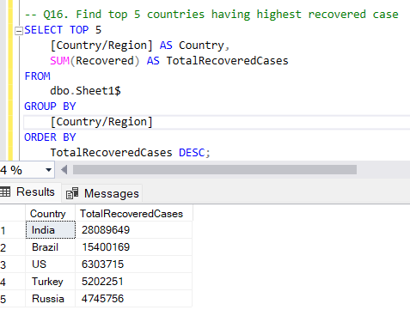
Geographical Analysis
Q16: Find top 5 countries having highest recovered case

Slide 18


CONCLUSIONS
Key Findings and Insights
Year 2021 Highlight: Identified 2021 as the year with the most critical cases.
Recovery Rate Focus: Directing attention to countries with the lowest recovery rates and highest death tolls.
Medical Priorities: Highlighting the importance of prioritizing medical resources in countries with the highest confirmed cases.
Seasonal Analysis: Emphasizing the significance of identifying the time of year with the highest virus spread to understand key contributing factors.

Slide 19
A heartfelt thank you for the opportunity to contribute to understanding the pandemic through data analysis
THANKS!

